Slide 1
Black Maternal Mortality
Presentation by: Shae O’Hurst, Akavayia Pressley-Dykes, Elleona Ragland, Destiny Young-Kline, and Tie Young

Slide 2
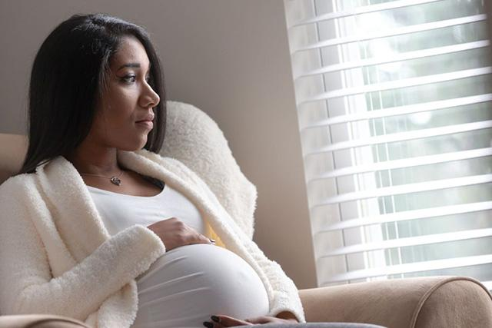
INTRODUCTION
This is Dominique; she is four months pregnant. She is feeling concerned after finding out that Black women like her have the highest rate of passing away before, during, or after giving birth to an infant.

Slide 3
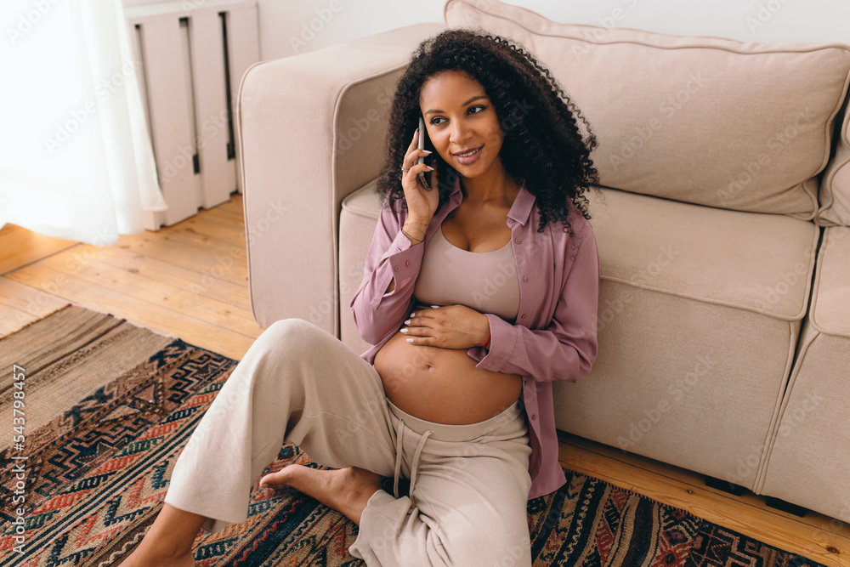
DOMINIQUE & RENEE
Dominique want to know more on Black maternal mortality so she can prevent it from happening to her. She calls her friend Renee who also happens to be a doula. Renee sends her a link to a video and more information on BMM.
Doula: A woman, typically without formal obstetric training, who is employed to provide guidance and support to a pregnant woman during labor.

Slide 4
Black maternal mortality is at an all time high in the U.S.

Slide 5
MATH STANDARDS
Ratios and Proportional Relationship 7.RP.A.3
Analyze proportional relationships and use them to solve real-world and mathematical problems.
3. Use proportional relationships to solve multistep ratio and percent problems. Examples: simple interest, tax, markups and markdowns, gratuities and commissions, fees, percent increase and decrease, percent error.

Slide 6
RENEE’S RESEARCH
Renee decides to do more research on BMM to gain a better understanding as a doula. To help inform her friend Dominique. Renee found charts, graphs and data on BMM.

Slide 7
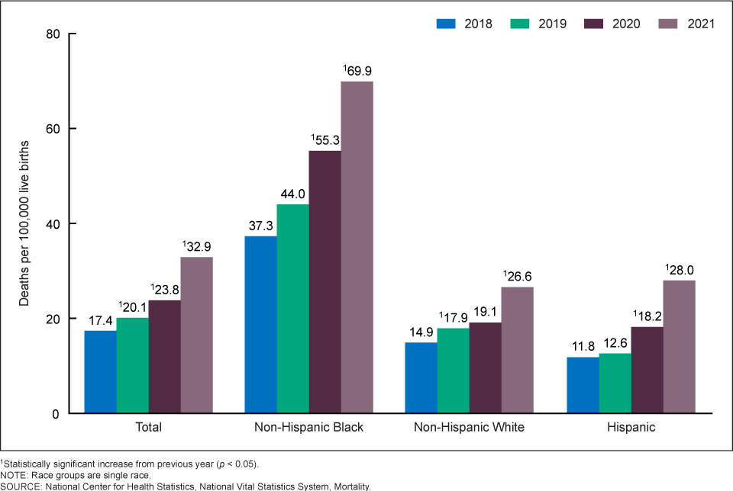
Figure 1. Maternal Mortality Rates, by Race and Hispanic Origin:
United States, 2018–2021
362 is the
number of Black women who died of maternal causes in 2021 in the United States;
up from 293 in 2020.
Source: Centers for Disease Control and Prevention: National Center for Health Statistics

Slide 8
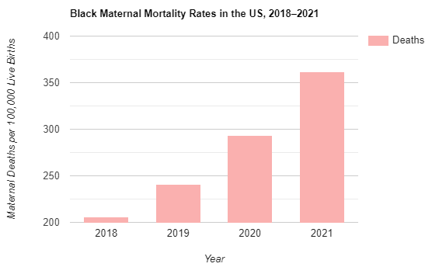
By What Percentage did the Black Maternal Mortality Rate Increase between 2018 and 2021 in the US?
Year | No. of Black Deaths
2018 | 206
2019 | 241
2020 | 293
2021 | 362

Slide 9
ANSWER
Step 1. Find the relative difference between the BMMR in 2021 and 2018
by subtracting 362 - 206 = 156
Step 2. Divide the relative difference by the original BMMR in 2018.
156.00/206 = .757
Step 3. To make this a percent, multiply .757 by 100 and Round it up to get 76%
Step 4. Interpret this percent increase:
The Black Maternal Mortality Rate increased by 76%
in the 4 years between 2018 and 2021.

Slide 10
Ratios and Proportional relationships 6.RP.A.1 & 6.RP.A.3
Understand ratio concepts and use ratio reasoning to solve problems.
Understand the concept of a ratio and use ratio language to describe a ratio relationship between two quantities. For example, “The ratio of wings to beaks in the bird house at the zoo was 2:1, because for every 2 wings there was 1 beak.” “For every vote candidate A received, candidate C received nearly three votes.
3. Use ratio and rate reasoning to solve real-world and mathematical problems, e.g., by reasoning about tables of equivalent ratios, tape diagrams, double number line diagrams, or equations.

Slide 11
Ratio between Black & White Maternal Mortality Rates
Look at the Maternal Mortality Rates for Non-Hispanic Blacks and Whites. Find the ratio between Non-Hispanic Black MMR and Non-Hispanic White MMR.
Year | Non-Hispanic Black Maternal Mortality Rate | Non-Hispanic Whites Maternal Mortality Rate
2018 | 37.3% | 14.9%
2019 | 44.0% | 17.9%
2020 | 55.3% | 19.0%
2021 | 69.9% | 26.6%

Slide 12
ANSWER
Step 1. Find the MMR for Non-Hispanic Black and Non-Hispanic White.
Step 2. Divide the MMR for Non-Hispanic Black by the MMR for Non-Hispanic White. Ex.(BMMR )/WMMR = 37.3/14.9 = 2.5
Step 3. Interpret the ratio:
In 2018, the Black Maternal Mortality Rate was 2 and a half times higher than the White Maternal Mortality Rate.
Year | Non-Hispanic Black Maternal Mortality Rate | Non-Hispanic Whites Maternal Mortality Rate
2018 | 37.3% | 14.9%
2019 | 44.0% | 17.9%
2020 | 55.3% | 19.0%
2021 | 69.9% | 26.6%

Slide 13
Maternal Mortality Rate of Black and White Women
Maternal mortality rates are deaths per 100,000 live births.
For example, in 2018, for non-Hispanic Black women over 40, there were 42 maternal deaths for 17,510 live births.
Hence, the rate =(42*100000)/17510 = 239.9
Year | 2018 |  |  | 2019 |  |  | 2020
Age Range | Under 25 | 25 - 39 | 40 and over | Under 25 | 25 - 39 | 40 and over | Under 25 | 25 - 39 | 40 and over
Non - Hispanic Black | 15.3 | 38.2 | 239.9 | 18.8 | 49.7 | 166.5 | 28.8 | 56.3 | 263.1
Non - Hispanic White | 10.5 | 13.8 | 72.0 | 13.1 | 16.8 | 75.2 | 11.5 | 17.6 | 96.8

Slide 14
QUESTIONS
In which year is the overall mortality rate the highest?
2. What is the percent increase in the mortality
rate for Non-Hispanic Black women under the age
of 25 from 2018 to 2020?
3. Calculate the percent difference in the
Maternal mortality rates of Non-Hispanic Black
women and Non-hispanic White women for the year
2020.

Slide 15
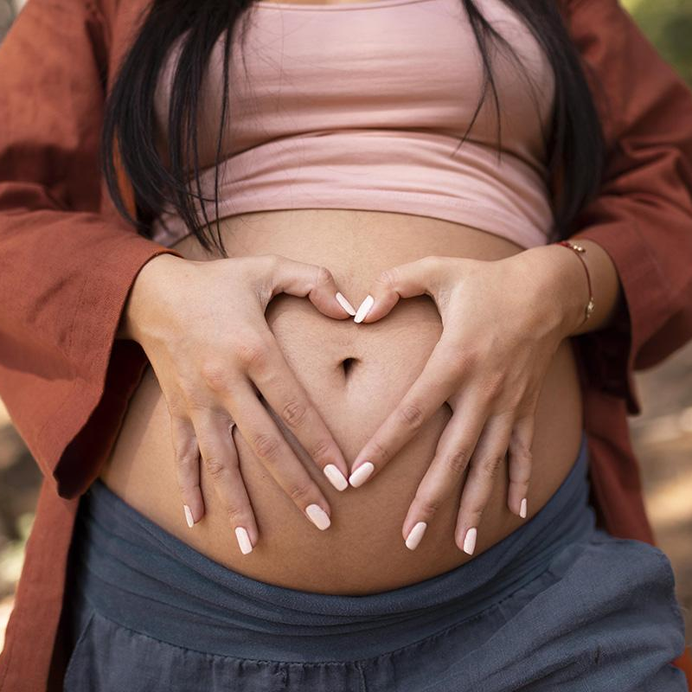
ANSWERS
2020
88.2%
3. 63.8%

Slide 16
What is the Disparity in Race & Education Level?
Read the “Education completed” characteristic data
Define whether it is True or False and the percentage rate of black women pregnancy mortality compared to white women : Attaining higher education significantly increases chances of surviving pregnancy and childbirth and by what percentage do they differ?Hint: This is only true for one of the groups of women.
PRMR = Pregnancy related mortality ratio
Answer key:
True for White women
False for Black women subtract each difference then gather all the different percentages together and divide them by 4 45.6-25=20.6 59.1-25.2=33.941-11.7=29.3 40.2-7.8=32.4 .They are 29.05 more likely to not survive compared to white women and their education. pregnancy

Slide 17
THE DISPARITY OF BMM REVIEW
Black women describe being neglected and dehumanized during their pregnancy, as well as a lack of access to prenatal care, and a slew of other injustices that result in trauma or death.
Black maternal death is on the rise, Black women are 3-4 times as likely to die from pregnancy-related problems than white women.
More than 360 black women die in the United States each year as a result of pregnancy problems, with experts estimating that at least 80% of these deaths are avoidable.

Slide 18
Dominique has been experiencing severe pain in the chest and stomach. When she went to the doctor they told her that she would be fine. What should she do?

Slide 19
WHAT SHOULD DOMINIQUE DO?
ADVOCATE
REPORT
It is crucial for her to advocate for her and her baby's health.
She can report or file a complaint if her medical needs are not being met. If pushed to do so she can file a lawsuit.
RESEARCH
GET SUPPORT
Dominique needs to do research on where to get better prenatal care and of her symptoms.
She can hire a doula for more support or confide in her family members.

Slide 20
WHAT ELSE CAN WE DO TO DECREASE BMM?
Consider ways to close the gap between birth outcomes, regardless of ethnicity or race.
Focus on African American women's healthcare experiences to prevent health complications affecting their pregnancies and birth.
Acknowledge and address systemic racism in the healthcare system.
Support Black women’s leadership efforts to address this crisis.
Improve women's health and access to quality care during preconception, pregnancy, and postpartum periods.
Notes:
barbara

Slide 21
Vocabulary
Black Maternal Mortality Rate (BMMR) | 70 Black mothers die for every 100,000 live births.
Disparity | A difference in level of treatment based on race, gender, age, etc.
Maternal Mortality | When the mother dies from pregnancy related health issues or an existing exacerbated condition.
Prenatal | Before Birth; during or related to pregnancy.

Slide 22
BIBLIOGRAPHY
Murphy, Laura, and Fuqin Liu. “A New Perspective on the Maternal Mortality Disparity.” Nursing Forum 57, no. 1 (2022): 171–76. https://doi.org/10.1111/nuf.12652.
Engaging African American women in research: An approach to eliminate health disparities in the African American community. Family Practice, 34(3), 322–329. https://doi.org/10.1093/fampra/cmx026
Hoyert, Donna L. “Maternal Mortality Rates in the United States, 2021,” 2023.
MacDorman, Marian F., Marie Thoma, Eugene Declercq, and Elizabeth A. Howell. “Racial and Ethnic Disparities in Maternal Mortality in the United States Using Enhanced Vital Records, 2016‒2017.”
American Journal of Public Health 111, no. 9 (September 2021): 1673–81. https://doi.org/10.2105/AJPH.2021.306375.
Petersen, Emily E. “Racial/Ethnic Disparities in Pregnancy-Related Deaths — United States, 2007–2016.” MMWR. Morbidity and Mortality Weekly Report 68 (2019). https://doi.org/10.15585/mmwr.mm6835a3.
Davis, Dána-Ain. “Reproducing While Black: The Crisis of Black Maternal Health, Obstetric Racism and Assisted Reproductive Technology.” Reproductive Biomedicine & Society Online, Reprotech in France and the United States: differences and similarities, 11 (November 1, 2020): 56–64. https://doi.org/10.1016/j.rbms.2020.10.001.
“Working Together to Reduce Black Maternal Mortality | Health Equity Features | CDC,” April 27, 2023. https://www.cdc.gov/healthequity/features/maternal-mortality/index.html.
YouTube. (2023). Why do Black women have the highest maternal mortality rates? YouTube. Retrieved July 19, 2023, from https://www.youtube.com/watch?v=Sc4YzG4l_Ls
https://www.cdc.gov/nchs/data/hestat/maternal-mortality/2020/E-stat-Maternal-Mortality-Rates-2022.pdf
https://resources.depaul.edu/newsline/sections/ask-an-expert/Pages/simonovich_pregnancy.aspx

Slide 23
THANKS!
To the staff of the Center for Measurement Justice
and our teachers:
Stacy Ebron, Jennifer Rodriguez, & Erin Nicole Cox

