Slide 1
DRess Codes
Hezekyah, Aaliyah, Kionte, Malik, Ava, BeverlyAnn

Slide 2
math standards
7.RP
7.EE
Ratios and Proportional Relationships
Expressions and Equations
7.RP Includes but isn’t limited to:
Calculate unit rates with fractions
Find the constant of proportionality
Identify equivalent ratios
Interpret graphs of proportional relationships
Solve percent equations
7.EE Includes but isn’t limited to:
Add and subtract linear expressions
Identify equivalent linear expressions
Evaluate multi-variable expressions
Solve two-step equations
Solve one-step inequalities
https://www.ixl.com/standards/common-core/math/grade-7

Slide 3
What is A dress code?
A set of rules specifying the guidelines that allow students to wear any type of clothing which meets the specifications mentioned by the school, whether they relate to the color, style, or stitch of the clothing

Slide 4
Types of dress code policies
Regulations
uniforms
Hair
Specific limitations to the type and length of clothing a student wears
The distinctive clothing worn by members of the same organization or body or by children attending certain schools
Dress code policies that regulate hair type, hairstyles, and hair color
Notes:
Regulations– ava, heze
Uniforms– Aaliyah and Beverly Ann
Hair–Kionte

Slide 5
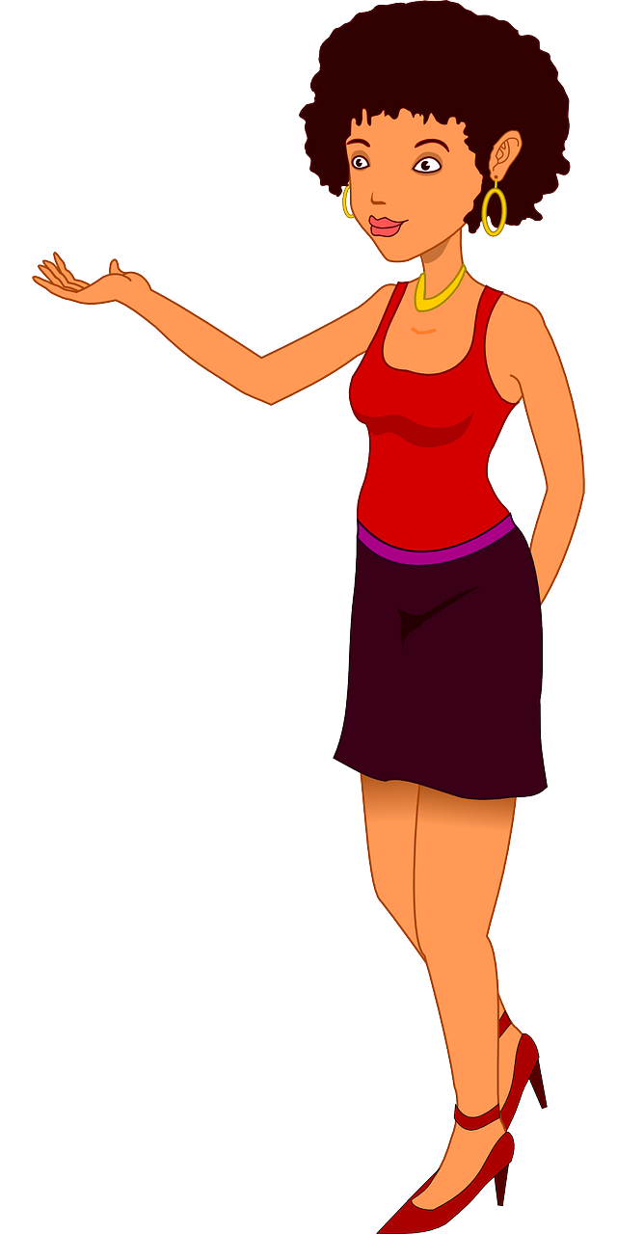
Hello! My name is Beverly. I go to Campbell High School, which is a public school!

Slide 6
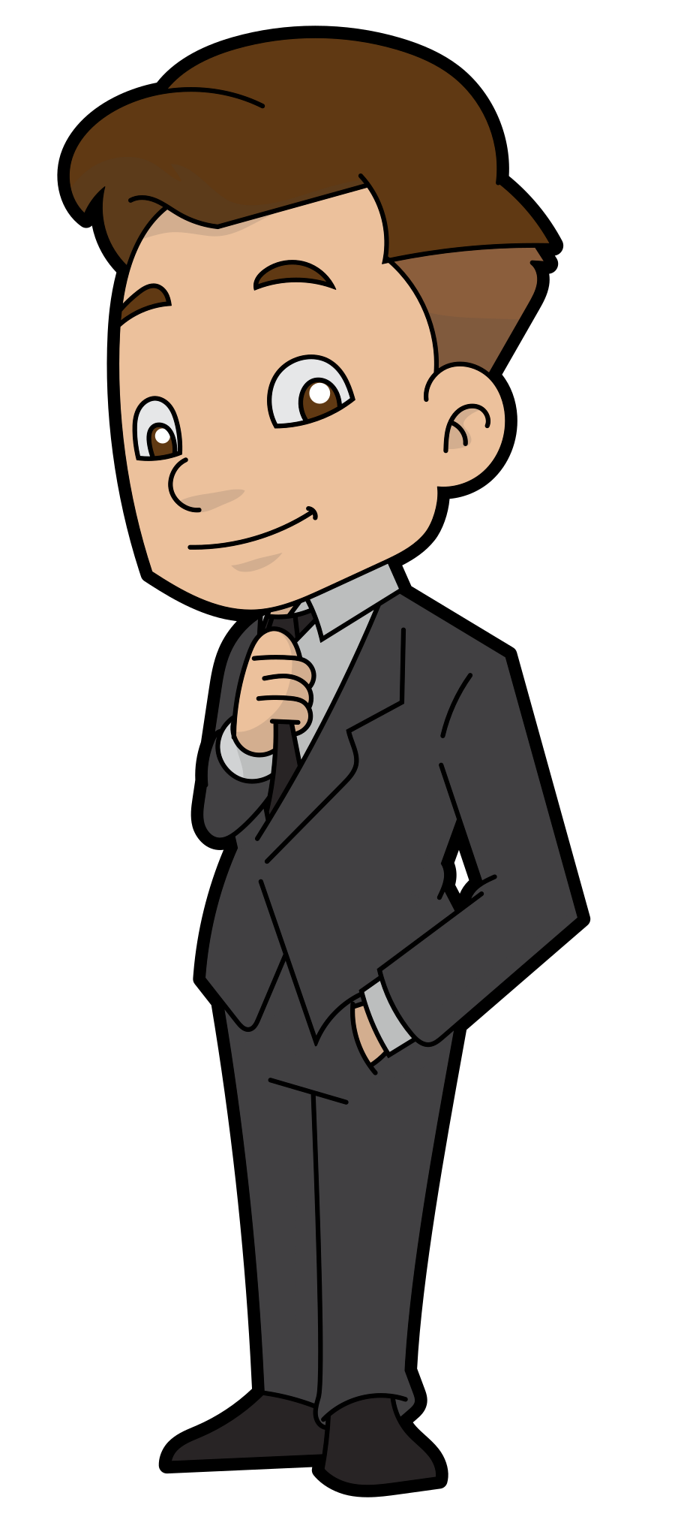
Beverly is called to the principal’s office during class

Slide 7
You should not be wearing that sort of thing at school, and your hair is unprofessional! I have no choice but to send you home.

Slide 8
You should let students wear what they want. My outfit nor my hair is not affecting anyone’s learning. However, you pulling me out of class has interrupted my learning.

Slide 9
Since you are refusing to listen to your teachers and defying the dress code, I am forced to suspend you!
What? That’s not fair!

Slide 10
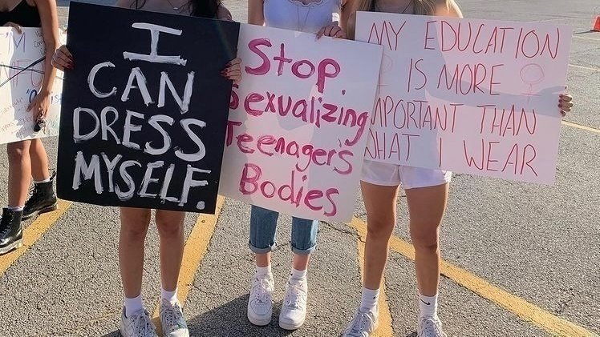
Beverly wants to do something about this issue, so she starts organizing students to bring awareness and call for change. She shares her findings at her school’s PTA meeting.

Slide 11
Dress Code Regulations Explained
Keep undergarments hidden
Skirts and shorts
01
03
Tank tops
necklines
02
04
Many schools allow skirts and shorts to be worn only if it meets the “fingertip” rule.
Bra straps, underwear underneath baggy pants, and undergarments showing are not allowed.
Spaghetti straps, strapless tops, muscle shirts, off shoulder shirts, and tank tops are not allowed.
Necklines can’t show too much cleavage.
Link: https://www.lovetoknow.com/parenting/teens/school-dress-codes

Slide 12
Dress Code regulations Explained
05
06
07
Leggings
Pajamas
No Gang related Clothing
No Vulgarity
No Bare midriffs
08
09
Leggings, spandex, tights, and other types of hosiery must be fingertip length or be worn with a long dress/top.
Pajamas can technically violate the dress code of no tank tops or baggy pants.
Specific colors, head coverings such as durags, jewelry, emblems or graffiti aren’t allowed.
No clothing with obscene swearing or sexual content, or any sort of profanity.
Bare midriffs are not to be shown.
Link: https://www.lovetoknow.com/parenting/teens/school-dress-codes

Slide 13
Dress Code regulations Explained
10
No overly bulky clothes
Tuck In shirts
11
Hats, sunglasses and piercings
Appropriate footwear
12
13
In some dress codes, shirts must be tucked in to show professionalism.
Heavy coats and baggy pants are discouraged from being worn in order to prevent weapons from being brought to school.
Shoes that are unbuckled, without straps, or with wheels increase a falling risk.
Hats may only be worn outdoors. Sunglasses prevent teachers from seeing if students are paying attention. Piercings on the face are a threat to school safety.
Link: https://www.lovetoknow.com/parenting/teens/school-dress-codes

Slide 14
Michigan City Area Schools dress code
Some of the main points include:
Clothing signifying gang-related activities, slogans, colors, etc. is prohibited.
Any clothing or appearance that is disruptive to the educational process is prohibited.
Skirts and shorts shall be no less than mid-thigh length.
Beachwear and pajamas are prohibited.
Michigan school board 2023 https://www.mcas.k12.in.us/dresscode

Slide 15
Pros ANd Cons Of Uniforms
Pros
cons
Increases students focus
Promotes school safety for the students
Increases the sense of community in school
Makes it easier for students to get ready in the morning
Promotes a less distracted learning environment
Uniforms can be discriminatory towards women and minority groups
Can be expensive for lots of parents
Limits student expression
Does not stop bullying
Restricts students freedom of expression
Drew, C. (2023, July 7). 35 Pros and Cons of School Uniforms (2023) - Debate points. Helpful Professor. https://helpfulprofessor.com/pros-and-cons-of-school-uniforms/

Slide 16
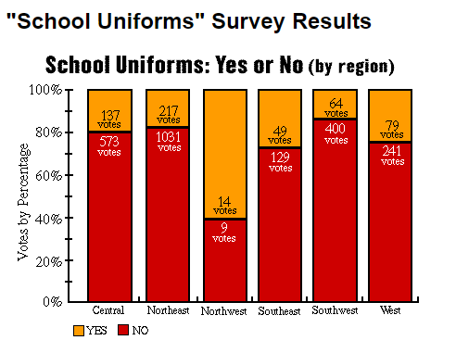
Question 1
Beverly shares to the PTA that 2,943 students around the United States were asked if public schools should have dress codes and the results are below. Use this graph to answer the following questions.
1. What is the probability that students voted that schools should not require school dress codes? 2. What is the probability that students voted that schools should require dress codes?
It’s the biggest planet to all
http://teacher.scholastic.com/kidusasu/uniforms/chart1.htm

Slide 17
Question 1 Answers
Beverly shares to the PTA that 2,943 students around the United States were asked if public schools should have dress codes and the results are below. Use this graph to answer the following questions.
1. What is the probability that students voted that schools should not require school dress codes?
1383/2943 = .47 OR 47% 2. What is the probability that students voted that schools should require dress codes?
1-.47 =.53 OR 53%
It’s the biggest planet to all
http://teacher.scholastic.com/kidusasu/uniforms/chart1.htm

Slide 18
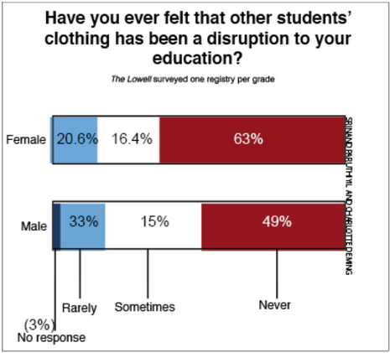
Question 2
A number of students were asked if they’ve felt like other students clothing disrupted their education.
What is the probability of students rarely having other students clothing disrupting their education? (Round to the nearest hundredth)
What is the probability of students never having other students clothing disrupting their education?
Link: https://thelowell.org/402/opinions/the-dress-code-is-unfair-and-vague-heres-how-to-improve-it/

Slide 19
Question 2 Answers
A number of students were asked if they’ve felt like other students clothing disrupted their education.
What is the probability of students rarely having other students clothing disrupting their education? (Round to the nearest hundredth)
(33+20.6)/200 = .27 = 27%
What is the probability of students never having other students clothing disrupting their education?
(63+49)/200 = 112/200 = .56 = 56%
Link: https://thelowell.org/402/opinions/the-dress-code-is-unfair-and-vague-heres-how-to-improve-it/

Slide 20
Question 3
In Beverly’s low-income neighborhood, she can buy a uniform for $75. Her friend Alex pays $125 in his neighborhood. What is the ratio of the cost of Beverly’s uniform to Alex’s uniform, expressed in simplest form?
5/3
3/5
1/2
1/3
How much does a school uniform cost? - CostHelper. (n.d.). CostHelper. https://education.costhelper.com/school-uniforms.html#:~:text=Typical%20costs%3A,the%20retailer%20and%20the%20location.

Slide 21
Question 3: Answer
In Beverly’s low-income neighborhood, she can buy a uniform for $75. Her friend Alex pays $125 in his neighborhood. What is the ratio of the cost of Beverly’s uniform to Alex’s uniform, expressed in simplest form?
75/125 = ⅗
How much does a school uniform cost? - CostHelper. (n.d.). CostHelper. https://education.costhelper.com/school-uniforms.html#:~:text=Typical%20costs%3A,the%20retailer%20and%20the%20location.

Slide 22
Question 4
Beverly’s younger brother needs to buy uniforms before school. Beverly finds two stores that sell uniforms. Store 1 sells 5 uniforms for $175 while store 2 sells 3 uniforms for $120. Which store has a better deal?
Store 1
Store 2
How much does a school uniform cost? - CostHelper. (n.d.). CostHelper. https://education.costhelper.com/school-uniforms.html#:~:text=Typical%20costs%3A,the%20retailer%20and%20the%20location.

Slide 23
Question 4: Answer
Beverly’s younger brother needs to buy uniforms before school. Beverly finds two stores that sell uniforms. Store 1 sells 5 uniforms for $175 while store 2 sells 3 uniforms for $120. Which store has a better deal?
175/5 = 35
120/3 = 40
35 < 40, so Store 1 has a better deal.
How much does a school uniform cost? - CostHelper. (n.d.). CostHelper. https://education.costhelper.com/school-uniforms.html#:~:text=Typical%20costs%3A,the%20retailer%20and%20the%20location.

Slide 24
Question 5
In 2018, 35% of girls wearing school uniforms have been sexually harassed in public. Find the number of girls at each school that have experienced this type of behavior. Round to the nearest whole number.
School Name | Total Number of Girls | Total Number of Girls Experiencing this Behavior
Arbor Preparatory High School | 411
WSC Academy | 49
Ypsi High School | 3,669

Slide 25
Question 5: answers
In 2018, 35% of girls wearing school uniforms have been sexually harassed in public. Find the number of girls at each school that have experienced this type of behavior. Round to the nearest whole number.
School Name | Total Number of Girls | Total Number of Girls Experiencing this Behavior
Arbor Preparatory High School | 411 | 411 x 0.35= 143.85 = 144
WSC Academy | 49 | 49 x 0.35= 17.15 = 17
Ypsi High School | 3,669 | 3,669 x .35= 1284.15 = 1284

Slide 26
Effects of dress code Policies
~Why This Matters~

Slide 27
“schools that enforce strict dress codes are associated with statistically significant higher rates of discipline that removes students from the classroom (e.g., suspensions, informal removals).
https://www.gao.gov/products/gao-23-105348

Slide 28
4/5
2/3
1/3
Who has strict dress codes?
Majority Black schools
Majority Hispanic schools
Majority white schools
https://www.gao.gov/products/gao-23-105348

Slide 29
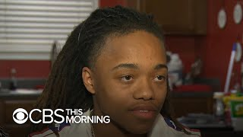
Video on Hair policies in school/school sports
Policies can be discriminatory towards traditional minority hairstyles
Protective styles should not be discriminated against
Hairstyles such as straight hair is deemed professional and acceptable
Afros, braids, and locs are seen as “unkempt”
A boy cannot walk across the stage at his graduation due to his locs in Texas. (0:00 - 1:55)
Notes:
0:00-1:00

Slide 30
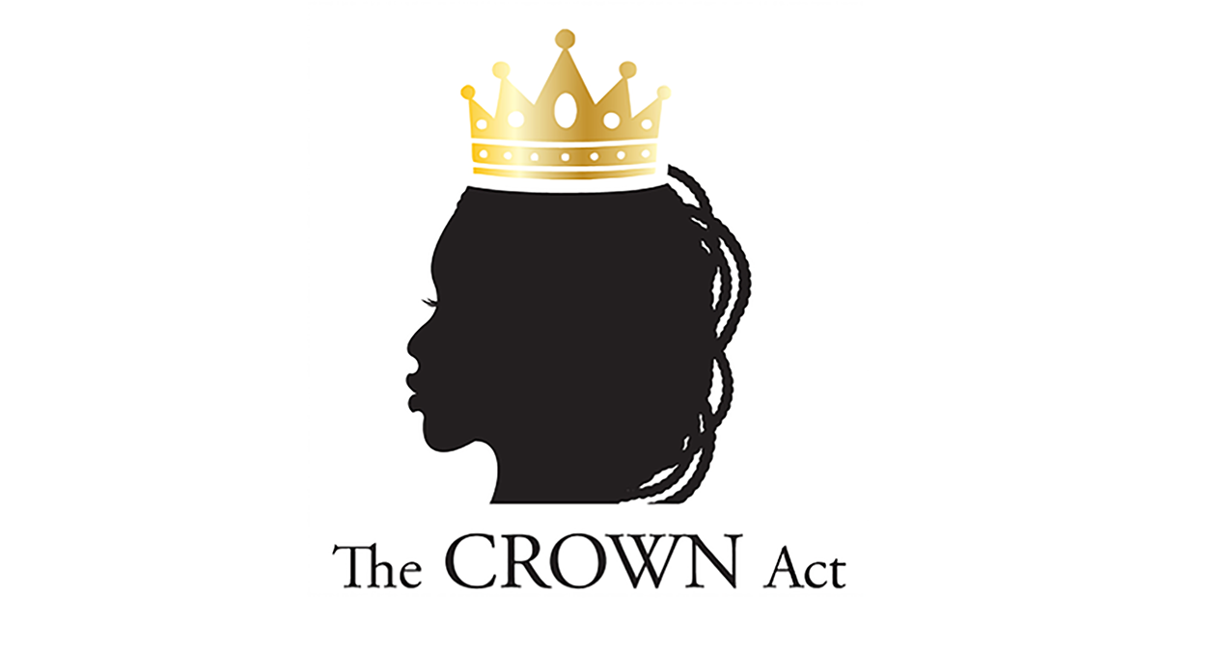
The Crown ACt
Creating a Respectful and Open World for Natural Hair

Slide 31
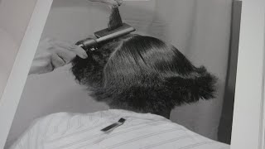
Crown Act Explanation
Living in a place where society criminalizes black hair is very costly
The alternative is usually chemicals that alter hair texture which can permanently damage hair
Black hair carries emotional significance.
(0:00-1:20; 3:28- end)
Halley, C. (2019). How natural black hair at work became a civil rights issue. JSTOR Daily. https://daily.jstor.org/how-natural-black-hair-at-work-became-a-civil-rights-issue/

Slide 32
Question: Call to action
How are you going to address the problem in your community?

Slide 33
tools: social media
Use Social media to help communicate and share information on dress codes!

Slide 34
Q & A

